Slide 1



Rehabilitation for persons with SCI in Africa: Rural Perspective
Dr Haleluya Moshi
Kilimanjaro Christiam Medical Centre and University

Slide 2
Rehabilitation (WHO Definition)
Rehabilitation is a health service for people who experience a decline in their functioning due to an illness, injury, surgery, disability or age. Its primary goal is to:
help regain, maintain or improve functioning so the person can lead an independent and fulfilling live

Slide 3
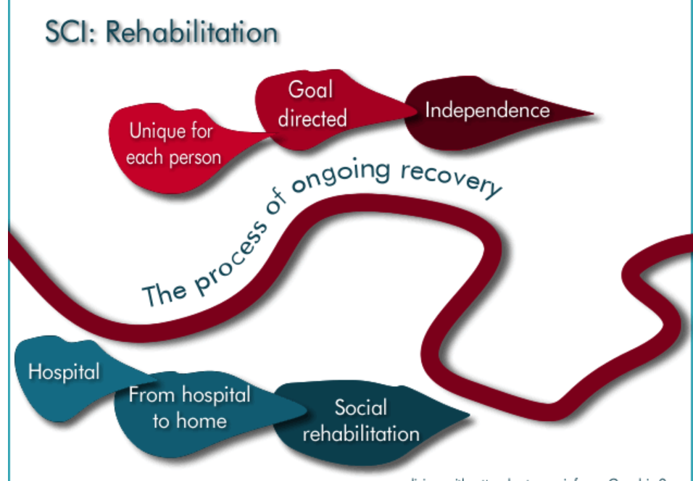
The journey is complex and everyone at own pace

Slide 4
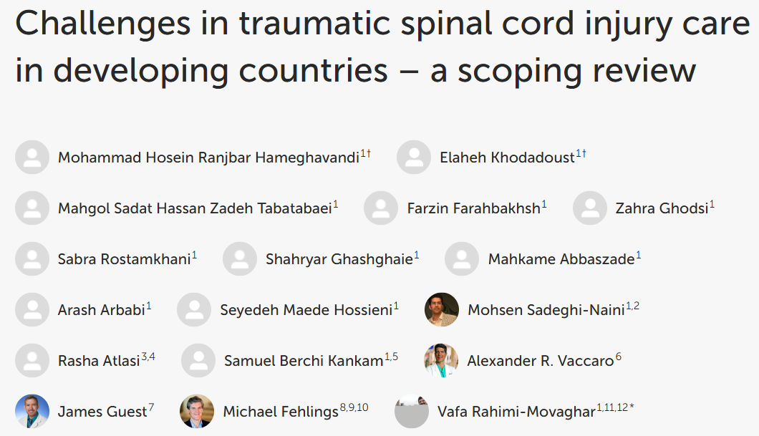
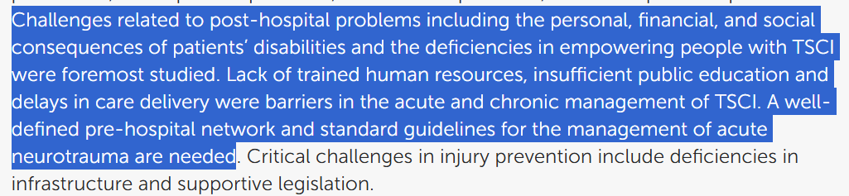

Slide 5
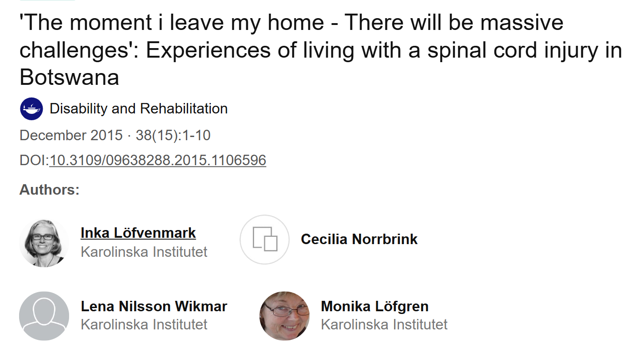
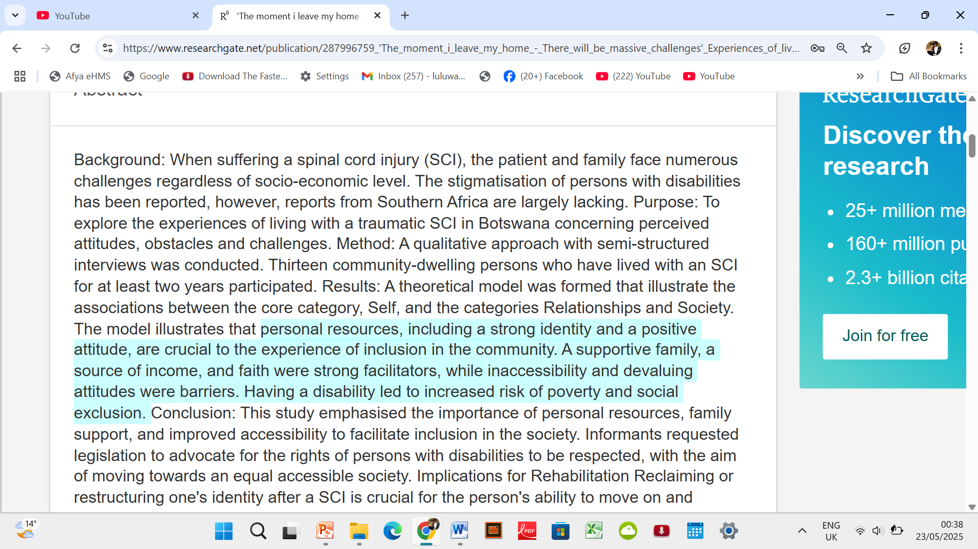

Slide 6
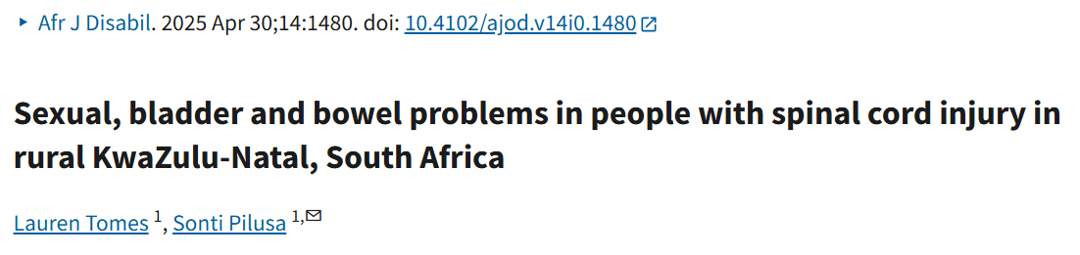
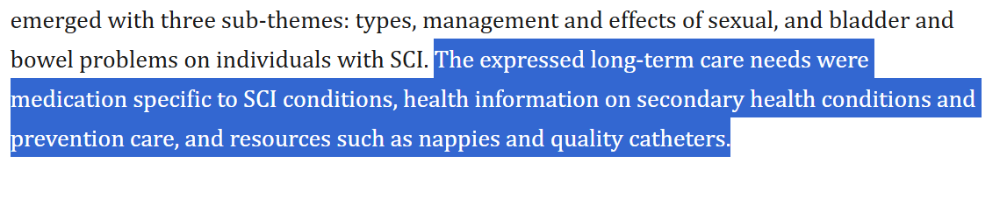
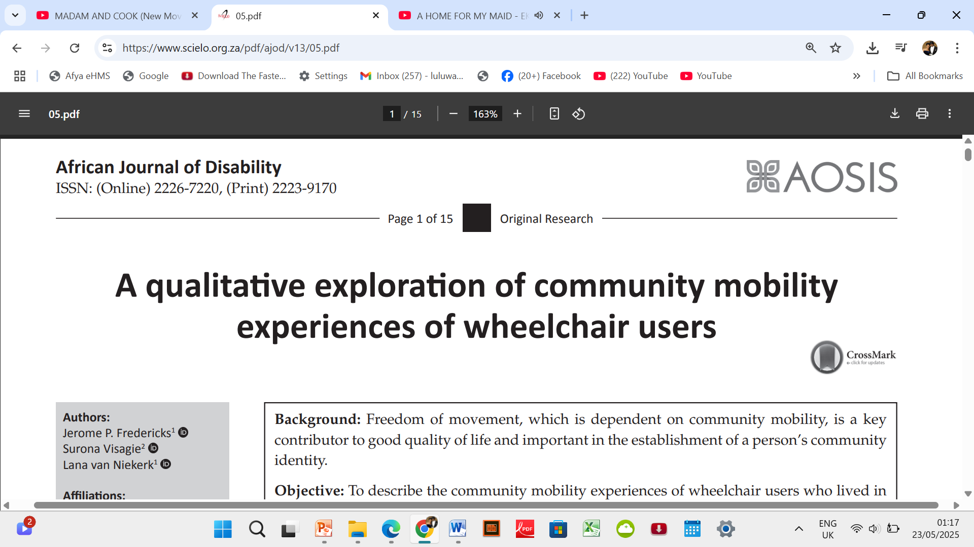
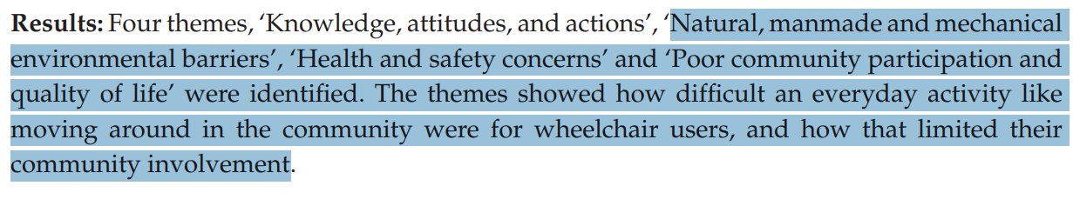

Slide 7
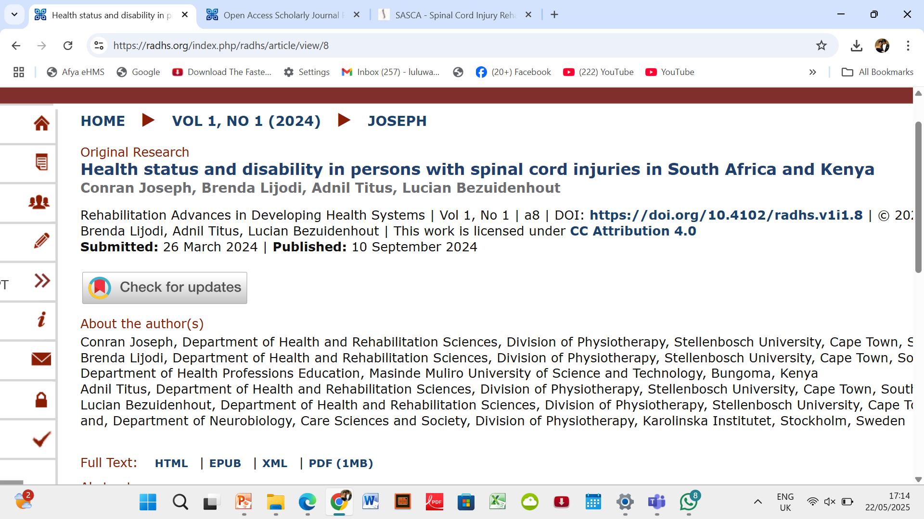
In both countries, sexual dysfunction (55% – 57%), pain (48% – 49%), spasticity (41% – 42%) and bladder dysfunction (27% – 60%) emerged as the predominant secondary medical complications
Both countries experienced similar overlaps in prevalent activity limitations and participation restrictions, including standing unsupported, using the toilet, bladder and bowel impairments, using public transport and reaching destinations.
The Kenyan cohort showed significantly higher prevalence rates compared to the South African cohort for challenges related to carrying out daily routines, getting to destinations and using public transportation, while maintaining intimate relationships was more prevalent in South Africa.

Slide 8
South Africa > 13 Centres dedicated to SCI Rehabilitation
Western Cape (Cape Town)
Western Cape Rehabilitation Centre – bed capacity 156
Life Vincent Pallotti Hospital
Gauteng
Tshwane Rehabilitation Hospital (Pretoria)
Life Riverfield Lodge (Johannesburg)
Netcare Rehabilitation Hospital (Johannesburg)
Mediclinic Muelmed (Pretoria)
KwaZulu-Natal (Durban)
Life Entabeni Hospital
Eastern Cape (East London)
Frere Hospital
Life St Dominic’s Hospital
Free State (Bloemfontein)
Life Pasteur Hospital
North West (Potchefstroom)
Witrand Hospital

Slide 9
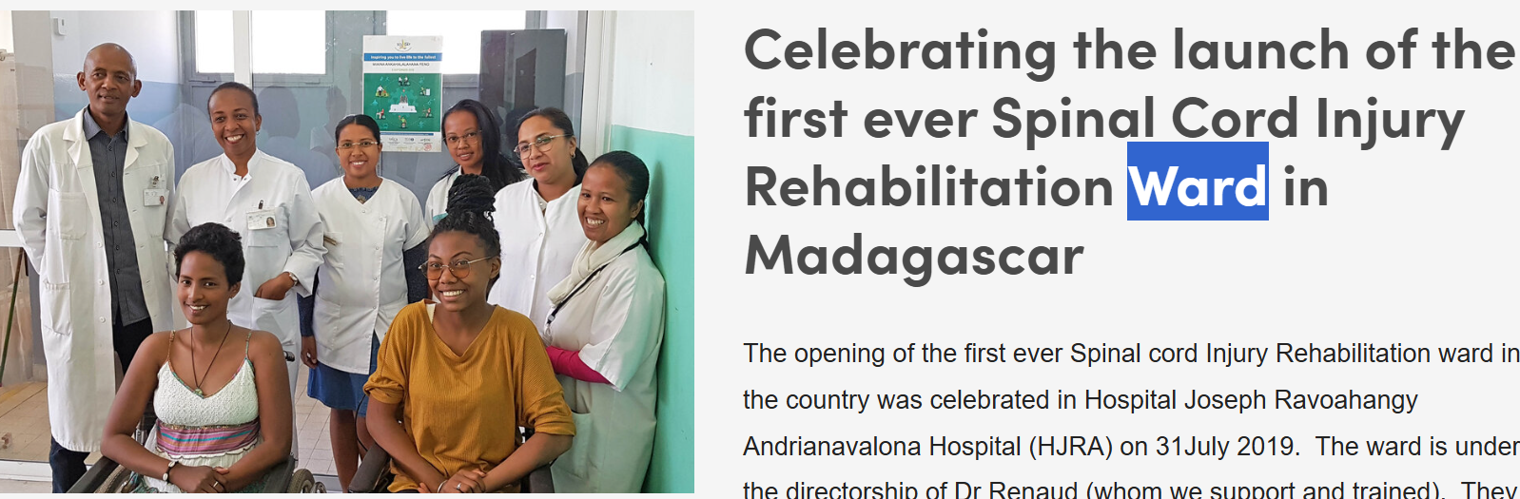
Malawi
Madagascar
University Hospital Joseph Ravoahangy Andrianavalona (Antananarivo)
Kachere Rehabilitation Centre (Blantyre)
Queen Elizabeth Central Hospital (Blantyre)

Slide 10

Namibia
Windhoek Central Hospital: Offers 19 beds dedicated to spinal cord injury
Zimbabwe
RUWA Rehabilitation Centre: A 52-beds

Slide 11
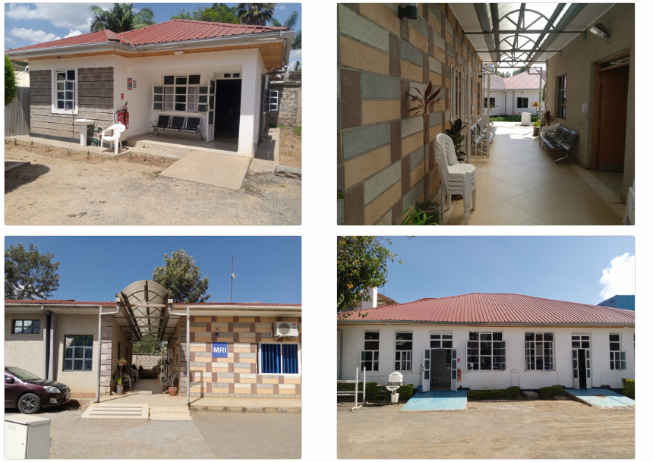
The National Spinal Injury Referral Hospital (NSIRH) – Kenya: 33 beds

Slide 12
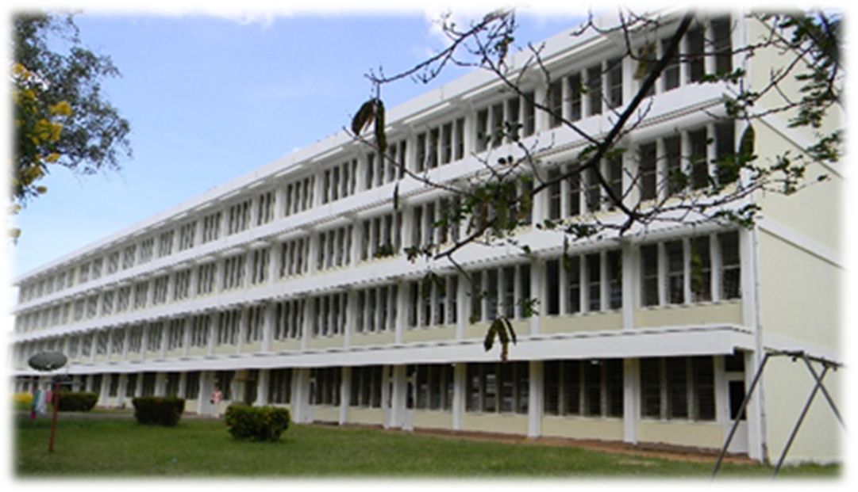
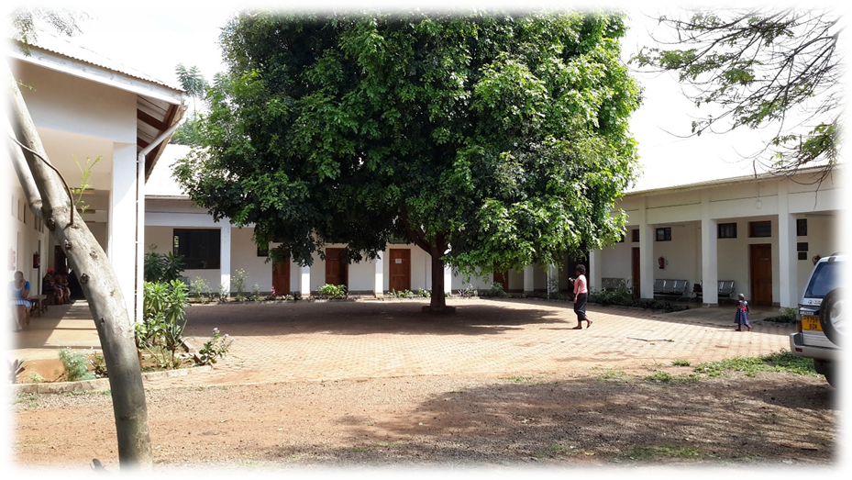
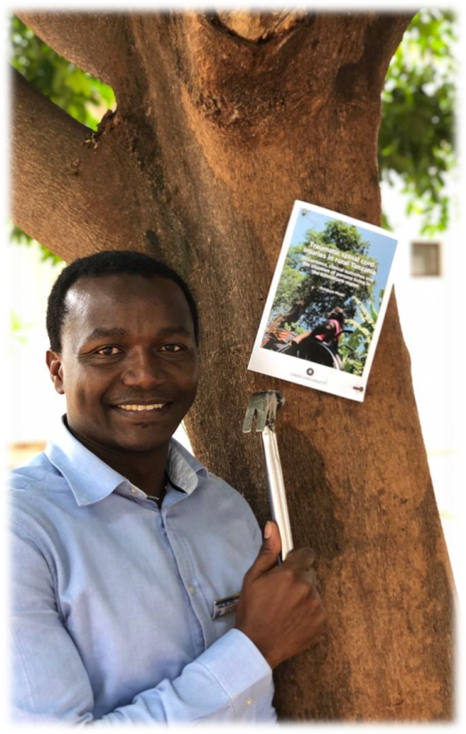
Kilimanjaro Christian Medical Centre

Slide 13

The Orthopedic Rehabilitation Unit (ORU) at Kilimanjaro Christian Medical Centre
24 beds for stabilised persons
For active rehabilitation
Strength: Multidisciplinary weekly ward round
Senior Occupational therapist
Senior Physiotherapist
Nurse in charge
Orthopedic surgeon
Neurologist
Neurosurgeon
Wheelchair technologist
Psychologist (on and off)
Urologist (on and off)

Slide 14
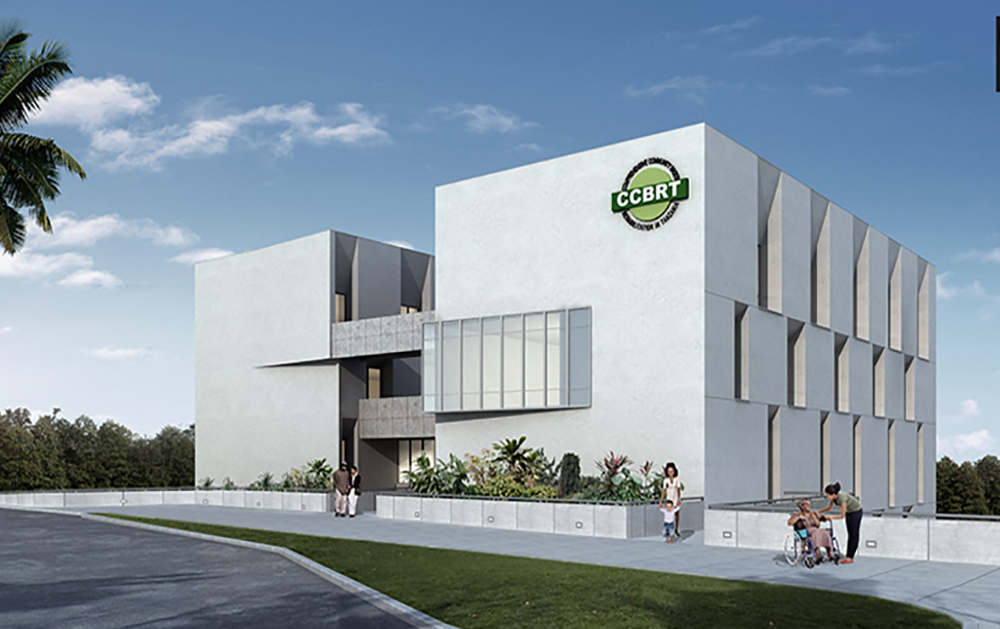
Comprehensive Community Based Rehabilitation - Tanzania
Supports all with any form of disability in the community countrywide.
Visual, reproductive health, children, adult, cognitive, physical….
Economic struggles from time to time
Priority seems to be children with Disability
SCI like a drop in the sea of so many other needs of persons with disability

Slide 15
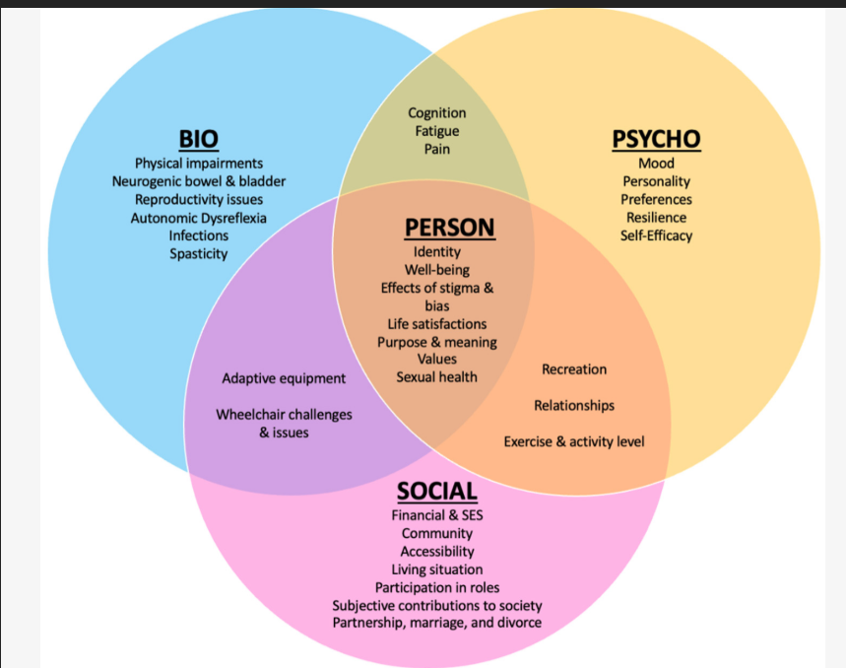
What expertise and services available in these centers ?

Slide 16
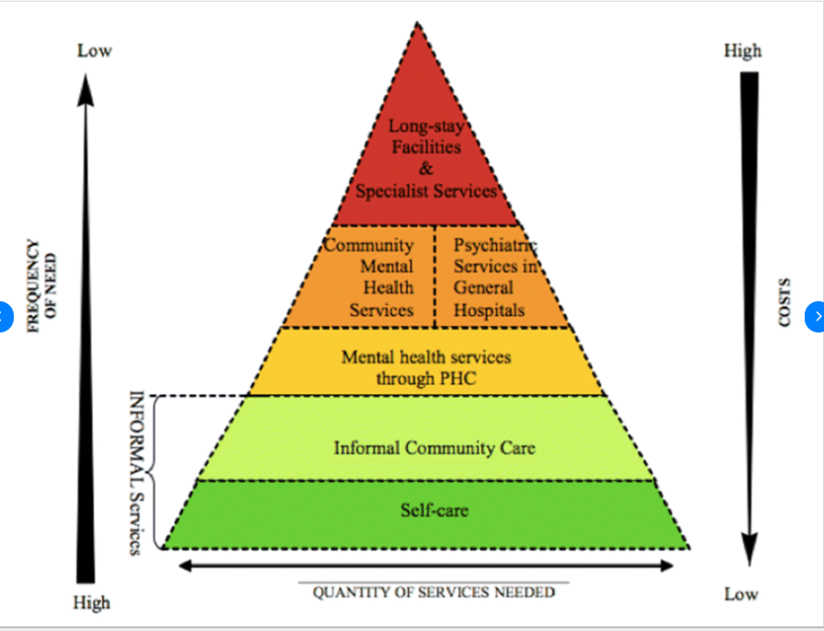
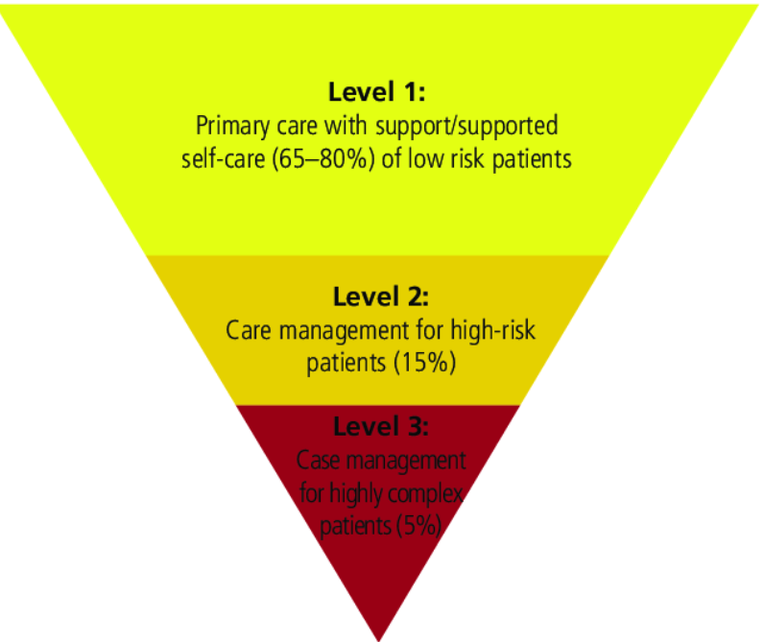
Where are the majority of people and where are the majority of rehabilitation services? Flip the Pyramid for rehabilitation services?

Slide 17
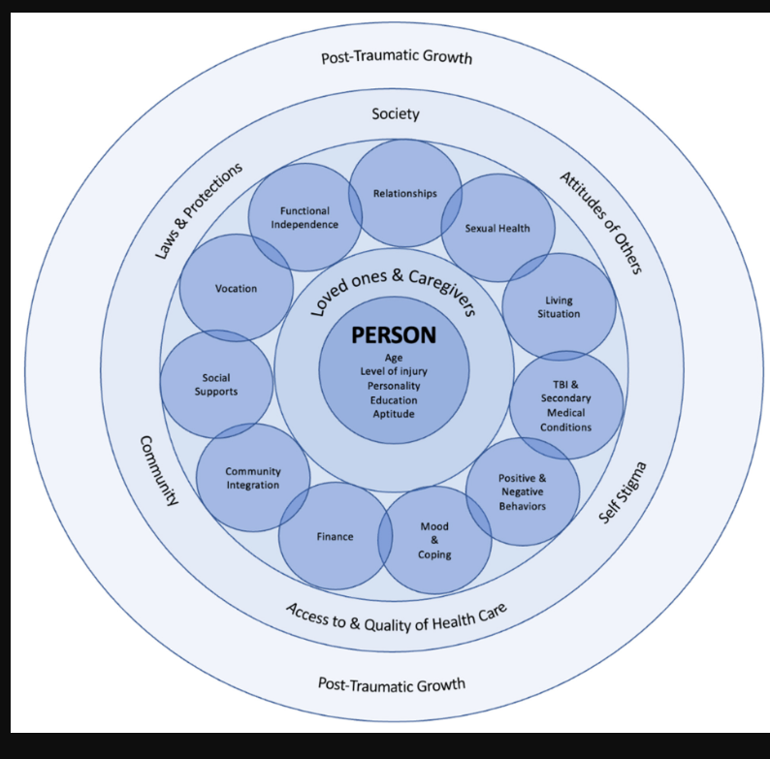
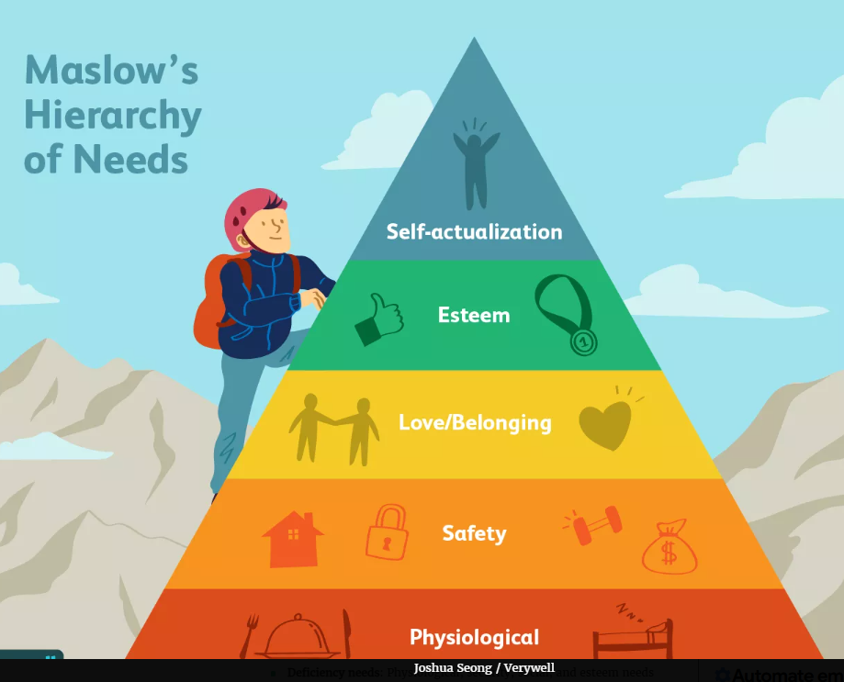
Is our Rehabilitation Service successful?
SCI related consequences

Slide 18
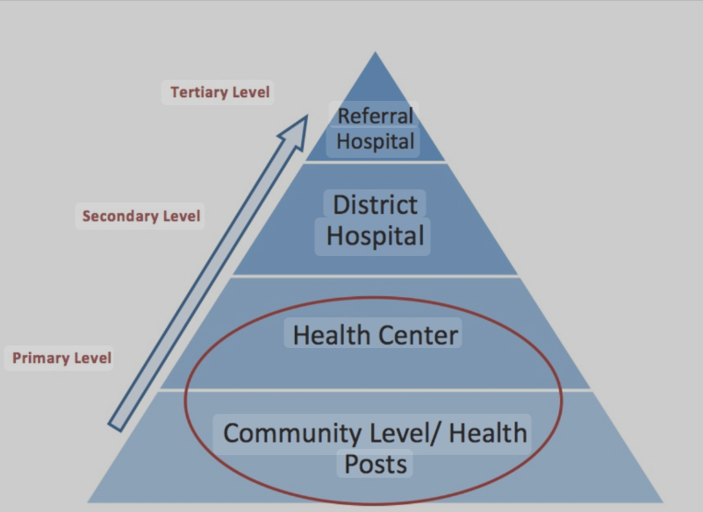
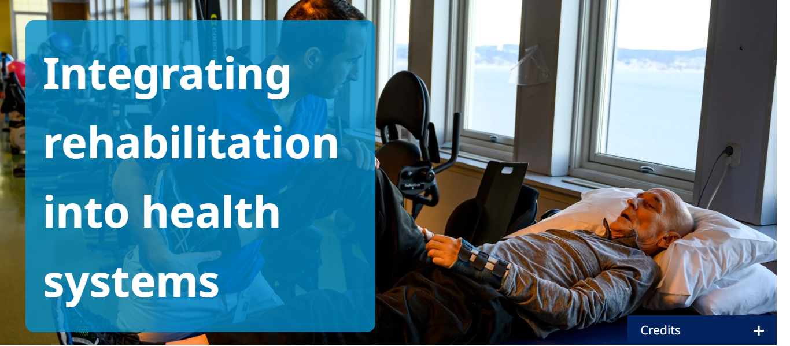
Way Forward
Advocacy for more SCI rehabilitation services at primary healthcare where the majority of the needs are.

Slide 19


Way Forward
Tele/Digital Rehabilitation …are we there yet?

Slide 20

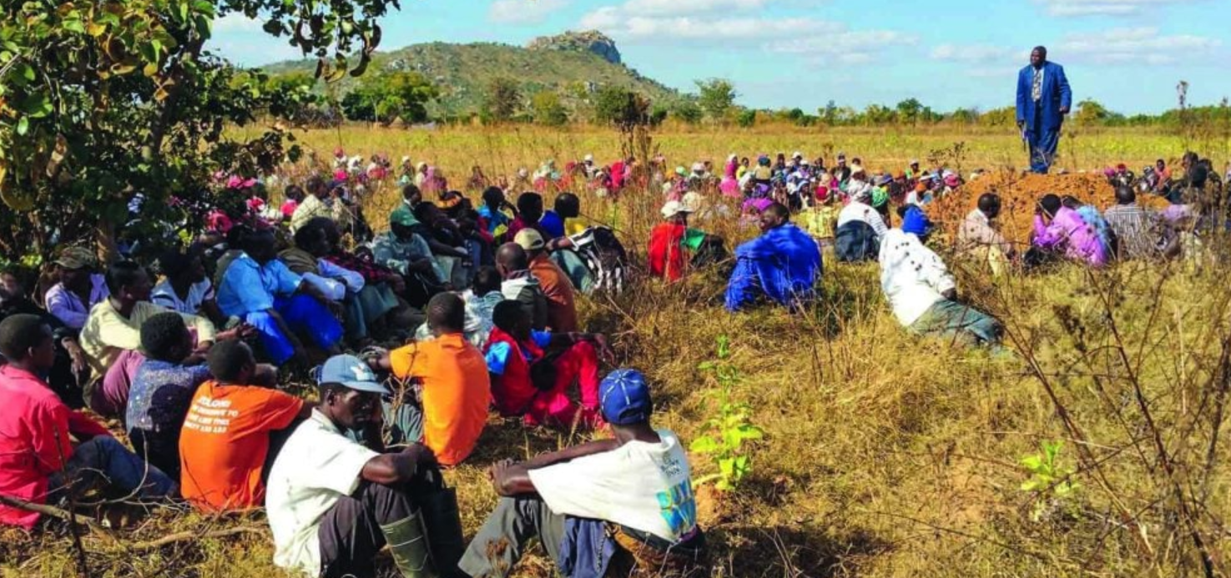
Way Forward
Are truly rehabilitation services unaffordable in the rural resource constrained areas or it is a matter of prioritization of things?

Slide 21
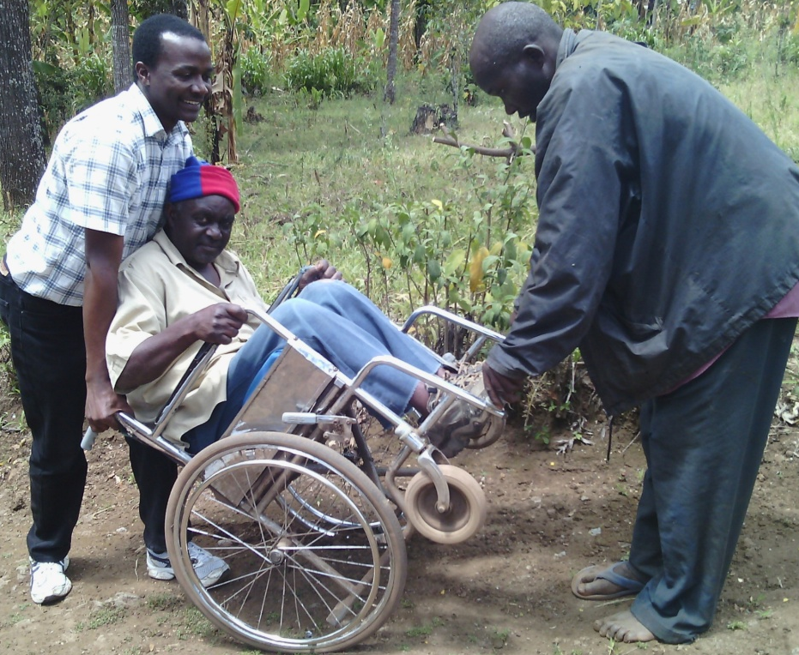
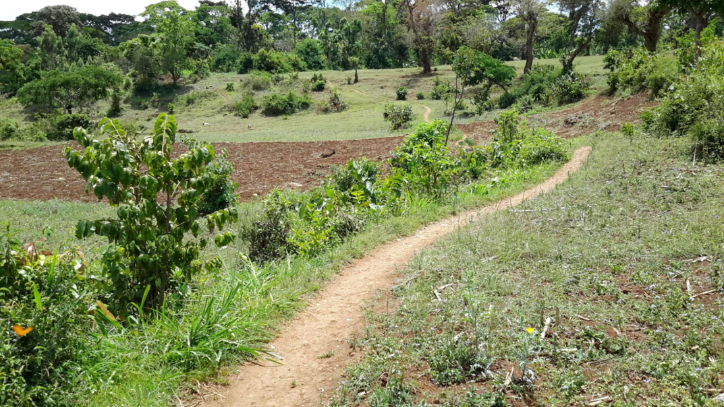
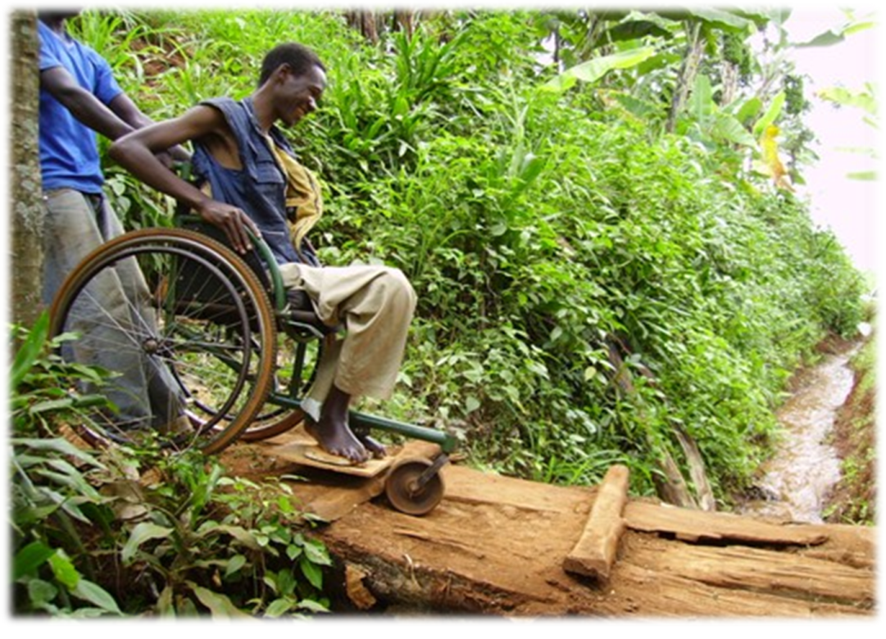
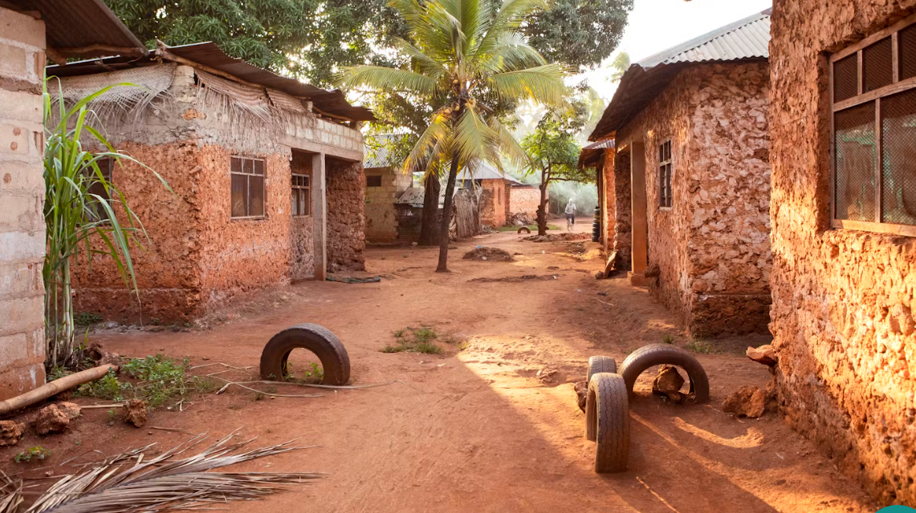
Accessibility, whose responsibility?

Slide 22


